Slide 1
Digital Image Processing in Python
Marcus Gallagher-Jones – marcusgj13@gmail.com
Day3
11/08/2018
https://github.com/marcusgj13/W21.DigitalImageProcessing

Slide 2
Day 3 overview
We are going to use some of the tools we learned about yesterday to write a simple algorithm to segment cells and track their positions.
I’ve tried to leave the code as close to the process in which I figured out the best way to segment the images so that you can get a better idea of what the process looks like.
After today you should know how to load in stacks of image. Separate elements within that image and retrieve properties about the individual elements.

Slide 3
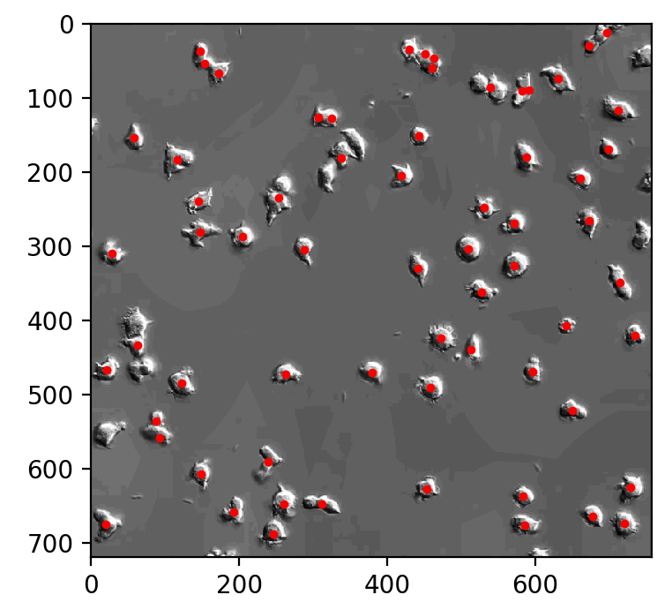
Day 3 overview

Slide 4
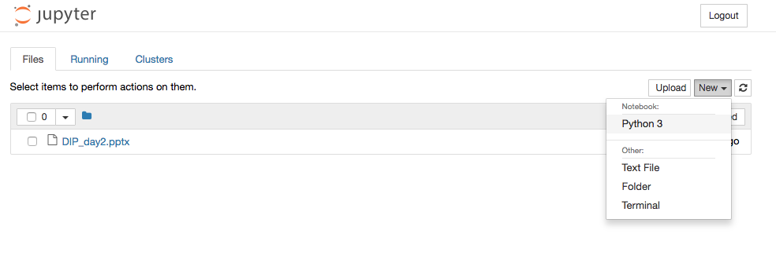
Let’s get started by opening up a new notebook

Slide 5
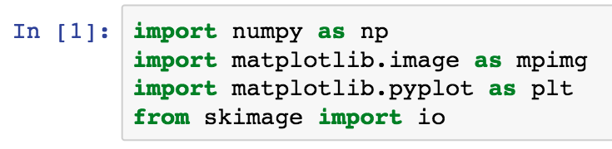
First load the necessary libraries

Slide 6
First load the necessary libraries
This one is new, we will see what it is for soon.

Slide 7
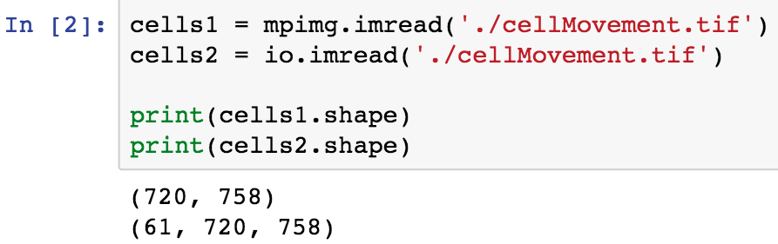
Load the provided tiff stack

Slide 8
Load the provided tiff stack
This is why it is always important to check image dimensions. Note that matplotlib’s imread does not load the whole stack.

Slide 9
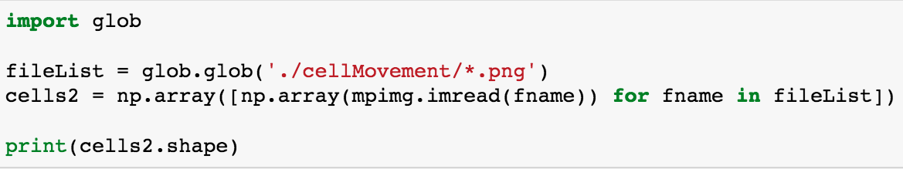
Alternative for windows

Slide 10
Alternative for windows
Glob is a python library that allows us to read in a list of all the files in a particular directory.

Slide 11
Alternative for windows
This statement is a compact form of a for loop. Essentially we are reading through all of the elements of fileList, loading the corresponding image as an array and appending it to a 3D array.

Slide 12
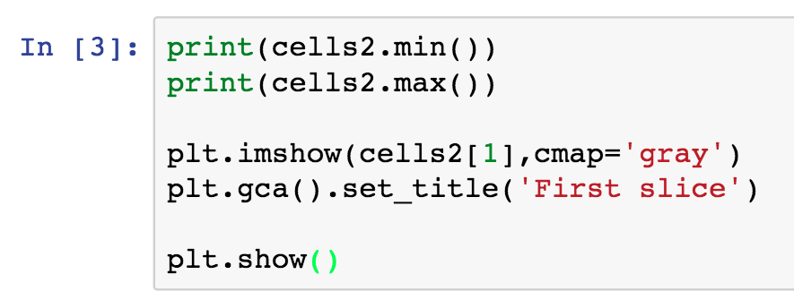
Display the image and check bit depth

Slide 13
Display the image and check bit depth
We can access individual frames using slices

Slide 14
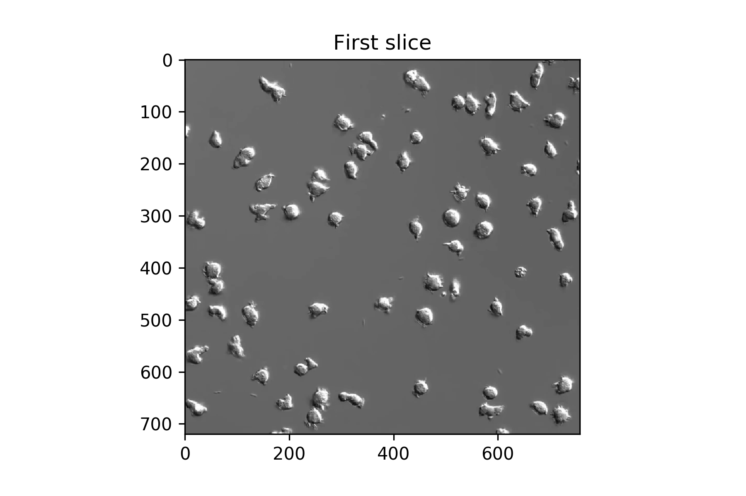
Display the image and check bit depth

Slide 15
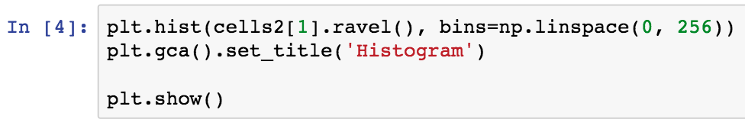
Check the image histogram

Slide 16
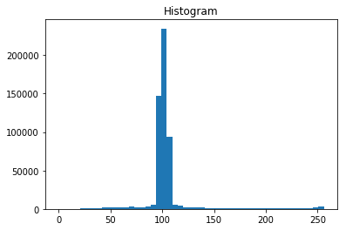
Check the image histogram

Slide 17
Check the image histogram
The values seem to occupy a narrow range. It may be a good idea to do histogram equilization to

Slide 18
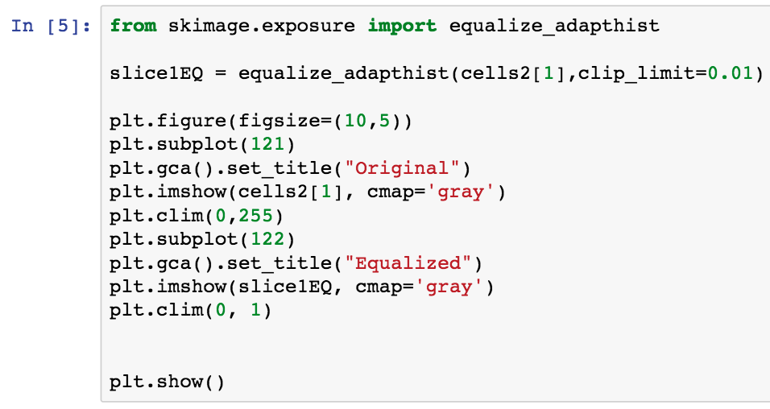
Perform the histogram equilization and display the result

Slide 19
Perform the histogram equalization and display the result
This clip limit was determined empirically by looking at the image and the histogram iteratively.

Slide 20
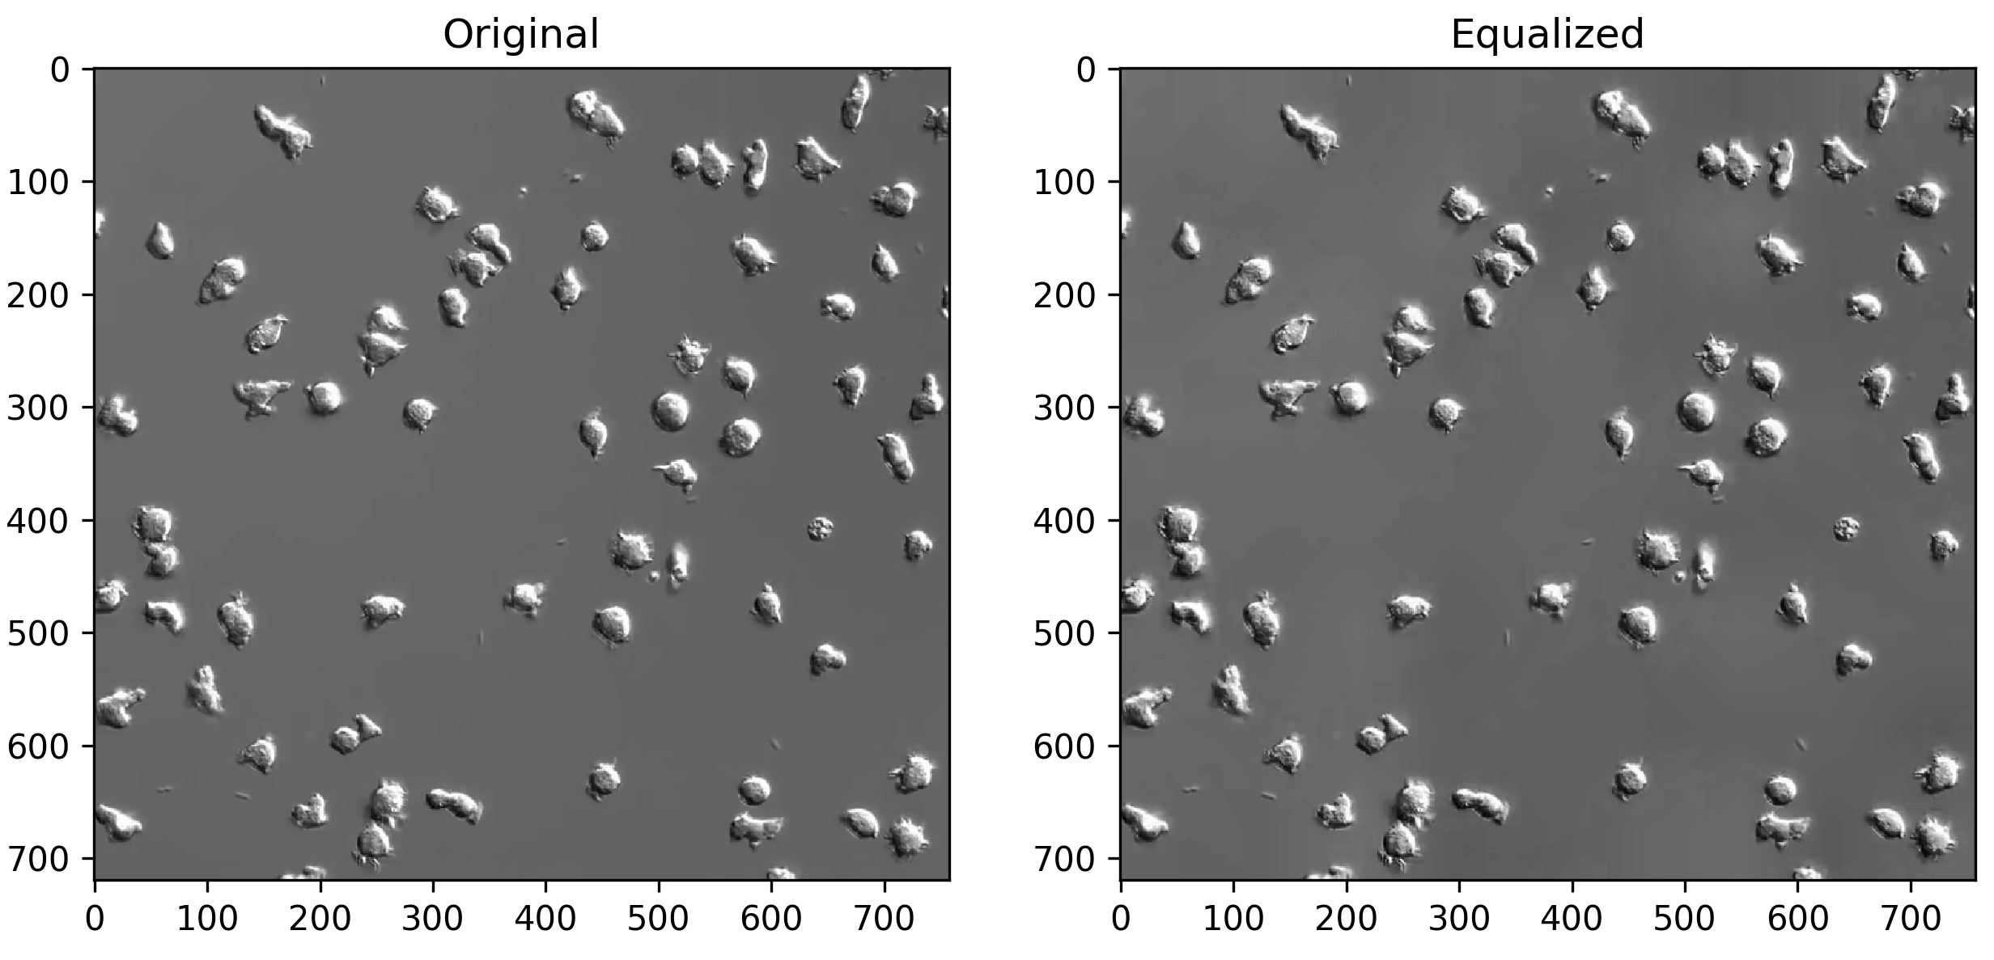
Perform the histogram equalization and display the result

Slide 21
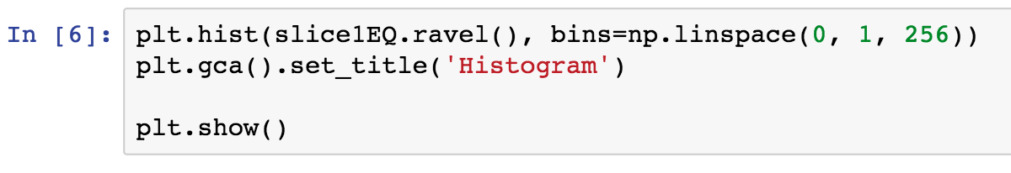
Check the equalized histogram

Slide 22
Check the equalized histogram

Slide 23
Check the equalized histogram
We’ve managed to spread out the values a little bit more but not too much. Since there is no obvious difference between background and cell we need another strategy.

Slide 24
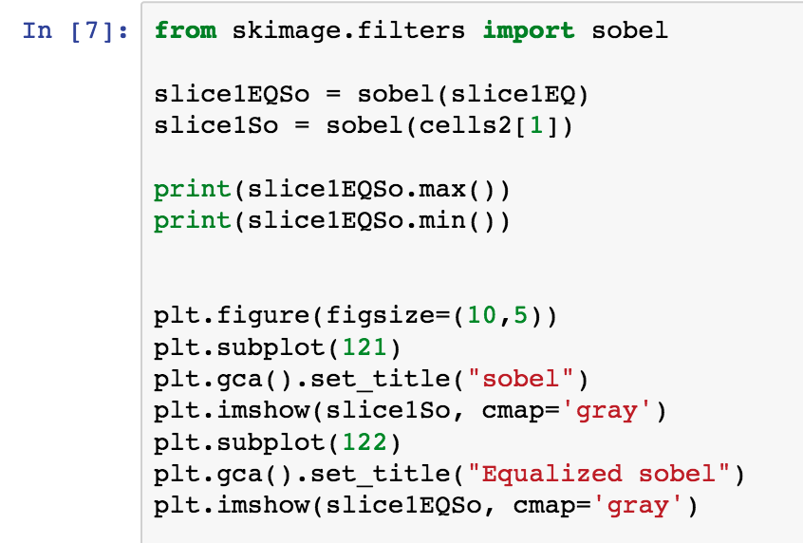
Edge detection to isolate cells

Slide 25
Edge detection to isolate cells
It is unclear what effect the histogram eq has had so we will check the filtering on both images.

Slide 26
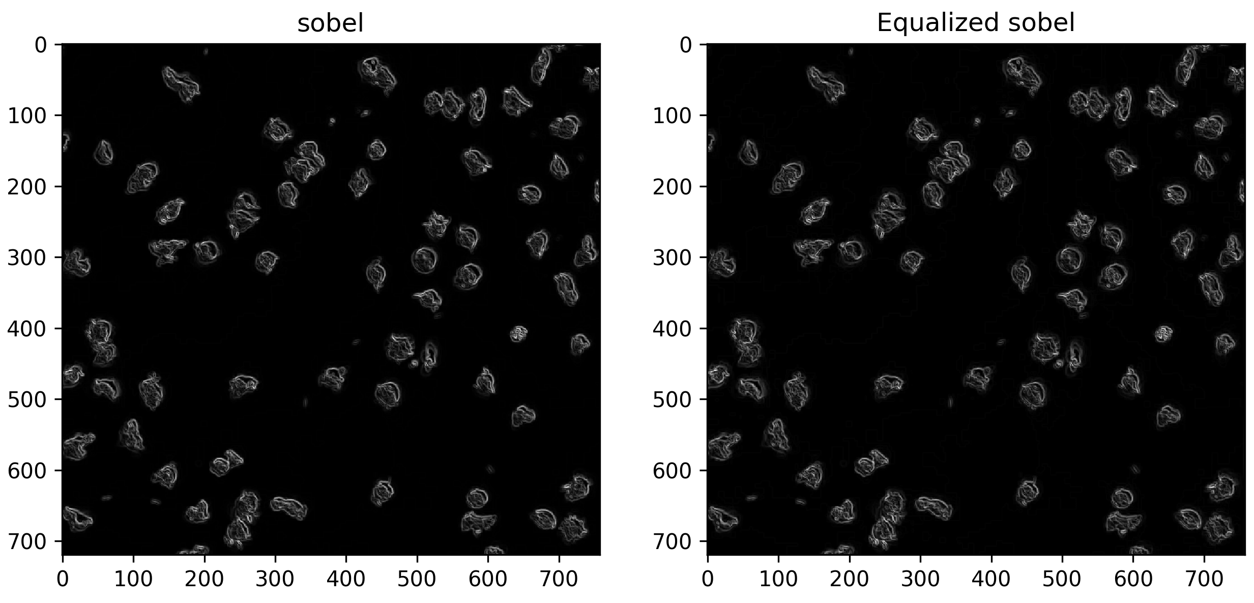
Edge detection to isolate cells

Slide 27
Edge detection to isolate cells
Not so much difference so maybe not useful for this particular dataset.

Slide 28
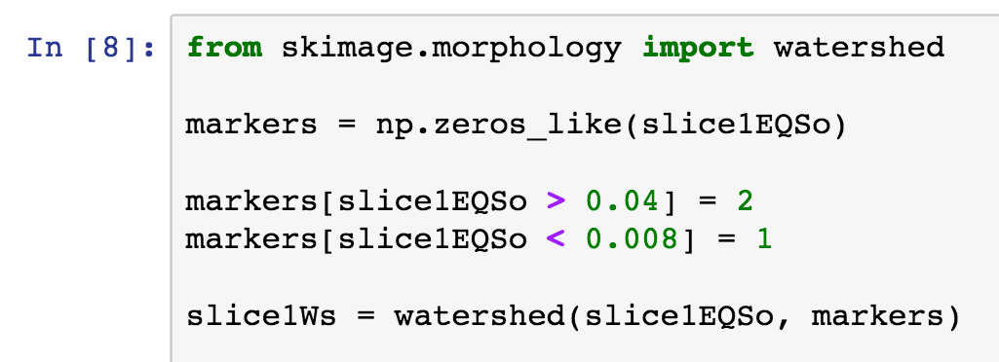
We can use the elevation map to perform an initial segmentation.

Slide 29
We can use the elevation map to perform an initial segmentation.
Again these values were determined empirically by modifying slightly and looking at the result.

Slide 30
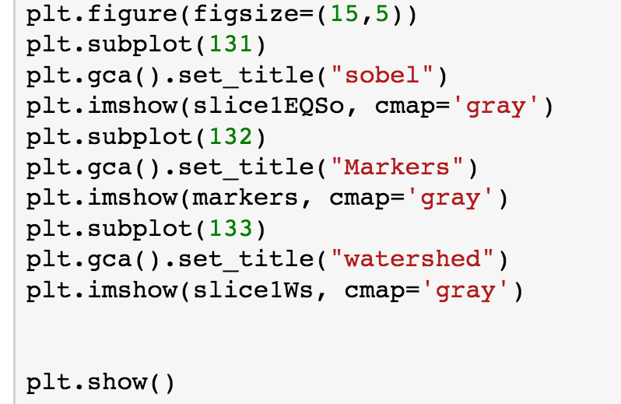
Plot the result to see how well the segmentation worked.

Slide 31
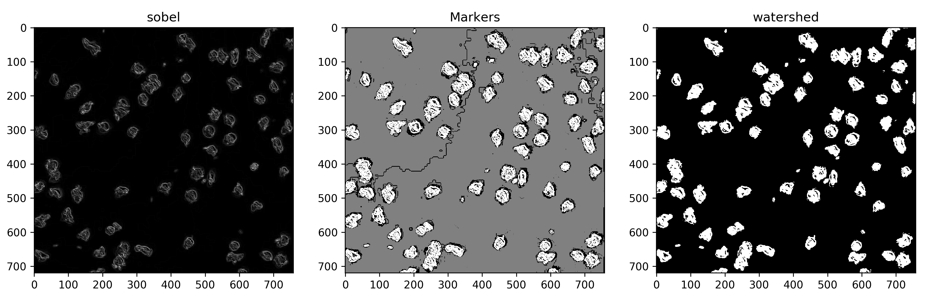
Plot the result to see how well the segmentation worked.

Slide 32
Plot the result to see how well the segmentation worked.
This result is not bad. It is still a little patchy but we can clean that up using morphological closing.

Slide 33
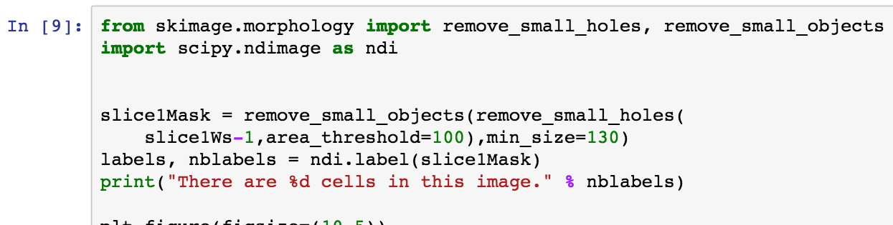
Clean up the segmentation result and label cells.

Slide 34
Clean up the segmentation result and label cells.
We can use the number of labels to get an estimate of the number of cells in the image.

Slide 35
Clean up the segmentation result and label cells.
As before we can play around with the parameters a bit to get the best possible binary mask.

Slide 36
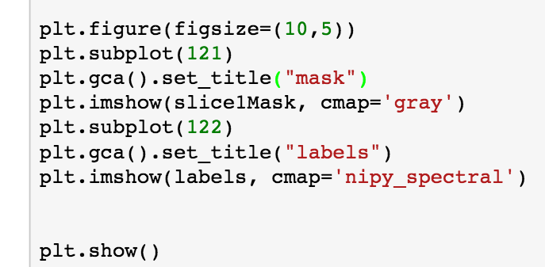
Clean up the segmentation result and label cells.

Slide 37
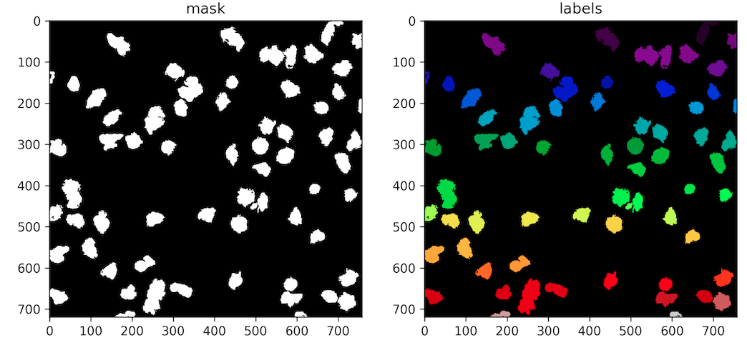
Clean up the segmentation result and label cells.

Slide 38
Clean up the segmentation result and label cells.
Not bad at all we got most of the cells. However notice that some of the cells that are touching haven’t been separated. Perhaps a second round of segmentation can clear this up?

Slide 39
Separating touching objects with the distance transform
Distance transform is an operator applied to binary images that returns a map where intensity represents the distance of a pixel to the nearest boundary.
We can use this map to provide markers for the watershed algorithm as to use as starting points.
For two objects that are touching, there will be a minima in the distance transform at their midpoint.
This is a useful way of separating them.

Slide 40
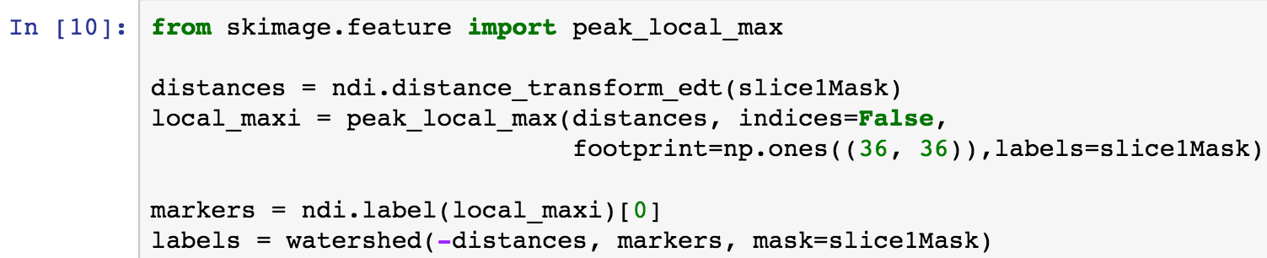
Separating touching objects with the distance transform

Slide 41
Separating touching objects with the distance transform
Peak_local_max returns a matrix the same size as the input image which contains the local highest intensity of a particular region. Footprint controls how big the search region is. Labels is used to define foreground and background.

Slide 42
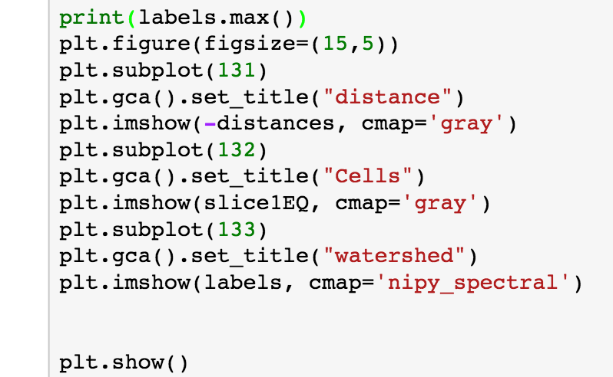
Separating touching objects with the distance transform
The maximum value of the labels tells us how many items were segmented. We can use this to see if extra cells were separated.

Slide 43
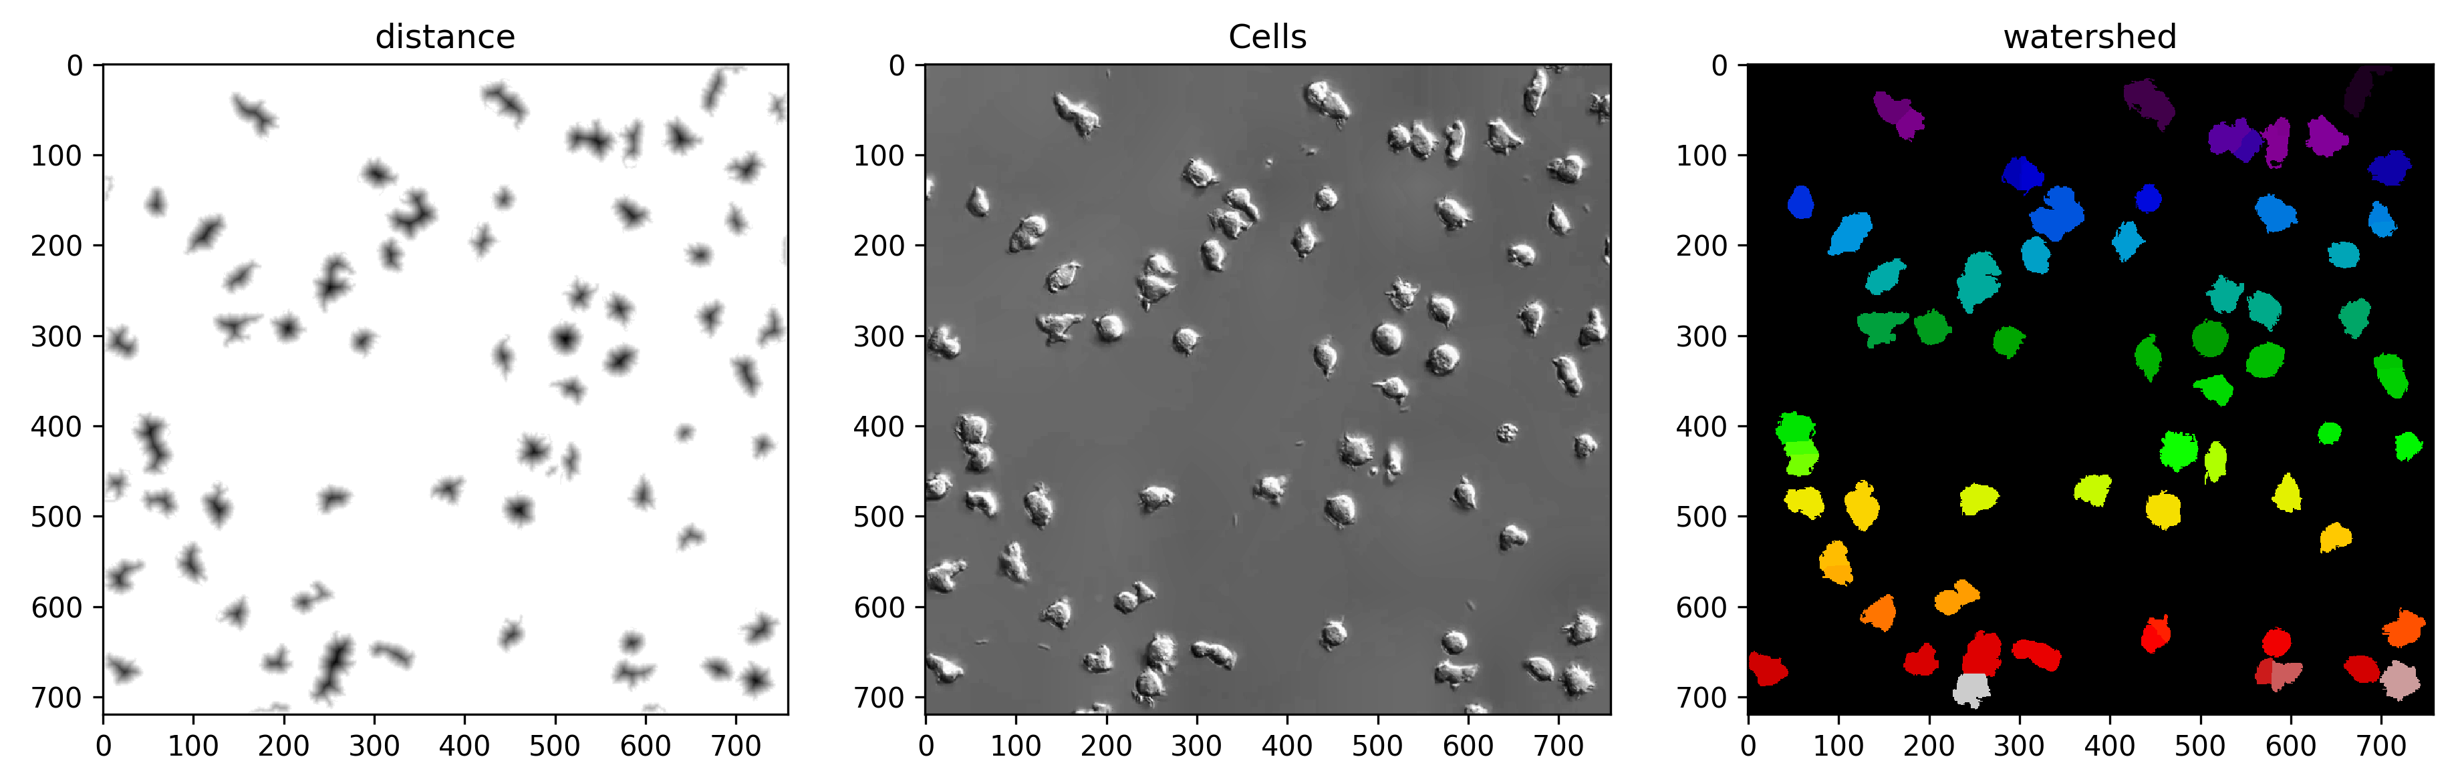
Separating touching objects with the distance transform

Slide 44
Separating touching objects with the distance transform
Great! We’ve managed to separate out some of the touching cells now.

Slide 45
Putting it all together
Ok now we have a strategy for separating all the cells it is a good idea to put all of this together.
We can now define a function that takes in an image and returns the segmentation labels.
This will allow us to perform the task on multiple images later.

Slide 46
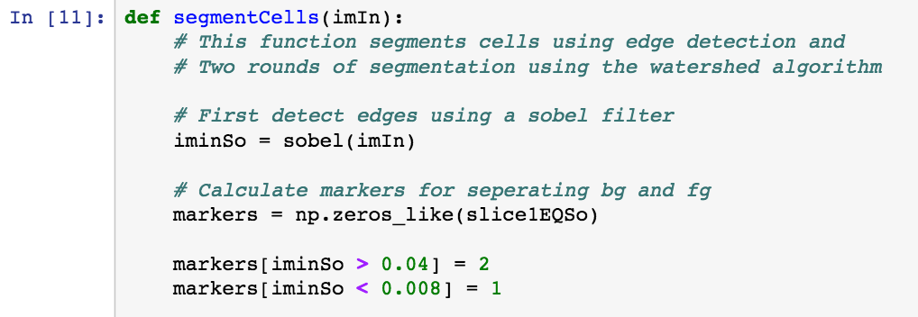
Cell segmentation function

Slide 47
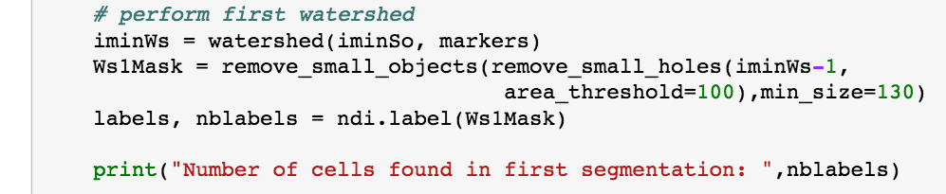
Cell segmentation function

Slide 48
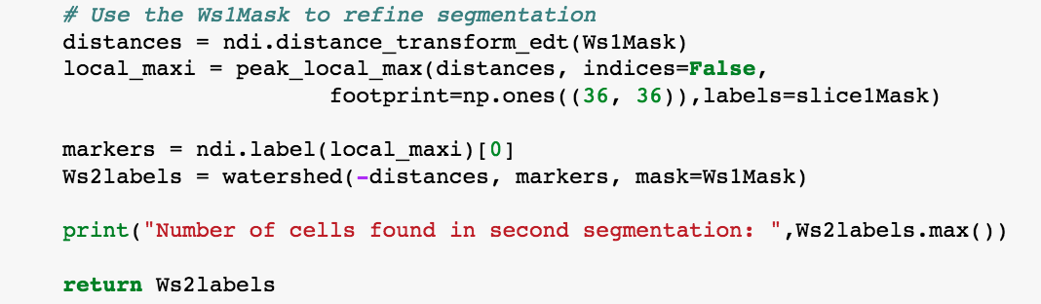
Cell segmentation function

Slide 49
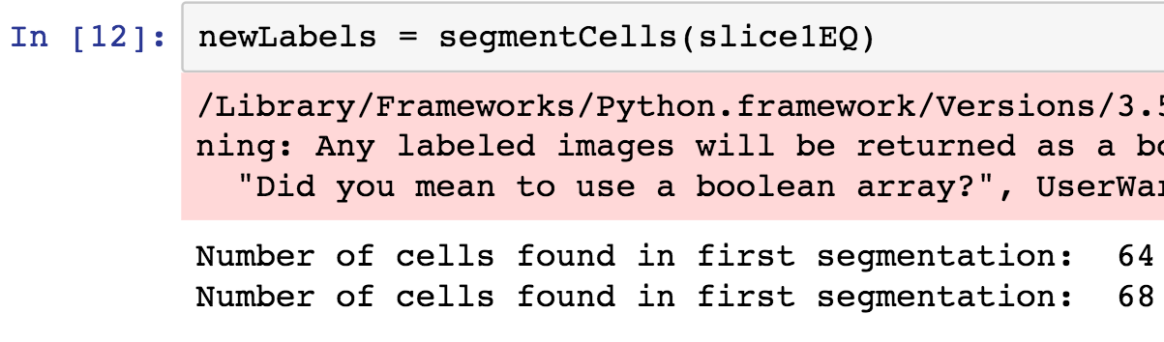
Let’s check out function to see that it works

Slide 50
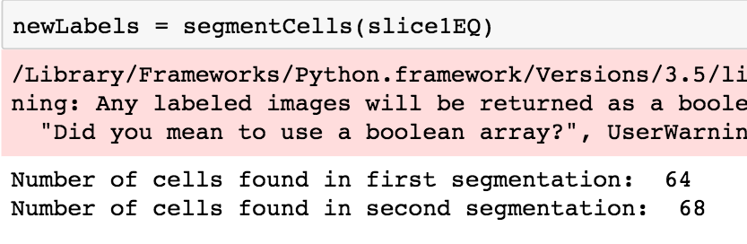
Let’s check out function to see that it works
Hopefully the output number of cells is the same.

Slide 51
Finding cell locations
Now that we have the segmentation working it is useful to know where the cells are in the image.
Skimage has a handy function called regioprops that can do this and a lot more.
Regionprops takes a series of labels as an input and returns an object containing lots of information about them such as size, centroid, area etc.
We can use the centroids of the labels to mark cell positions.

Slide 52
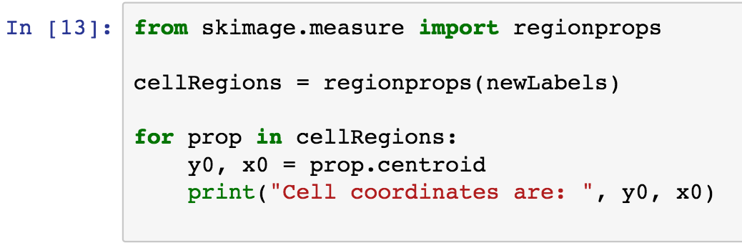
Finding cell locations

Slide 53
Finding cell locations
Using a for loop we can extract the xy location of all cells.

Slide 54
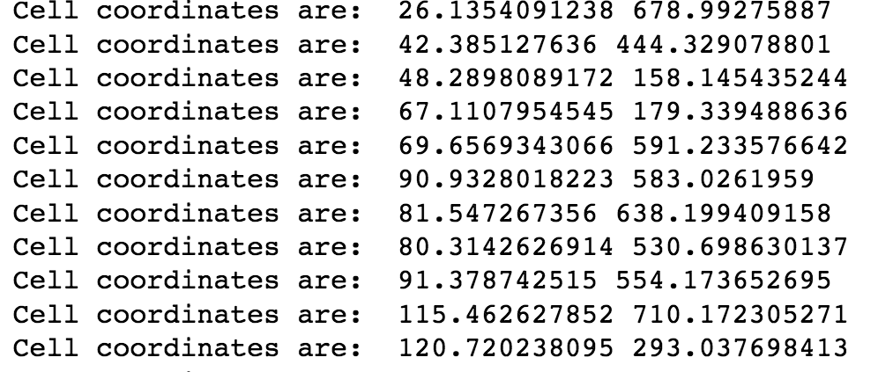
Finding cell locations

Slide 55
Storing cell locations
Print the positions out on the screen is nice but it is much more useful to store this information.
The easiest way to do this is to create a 2 by n (where n is the number of cells) matrix and iteratively populate it with the coordinates.

Slide 56
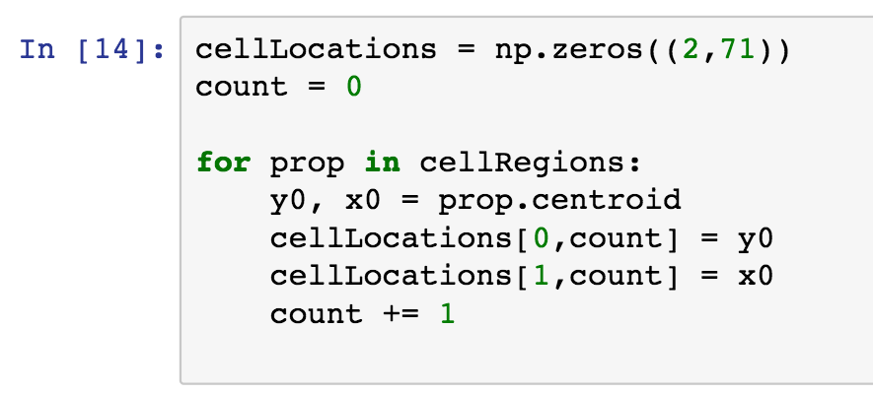
Storing cell locations

Slide 57
Storing cell locations
We use the count variable to keep track of the current index.

Slide 58
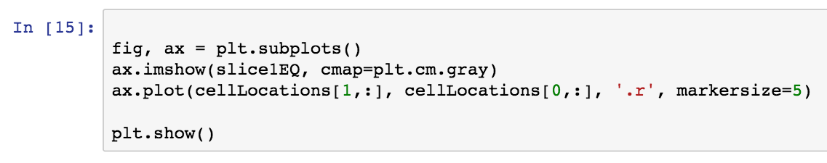
Labelling the cells on an image

Slide 59
Labelling the cells on an image
You’ll notice we change the way we are plotting ever so slightly so that we can overlay the coordinates.

Slide 60
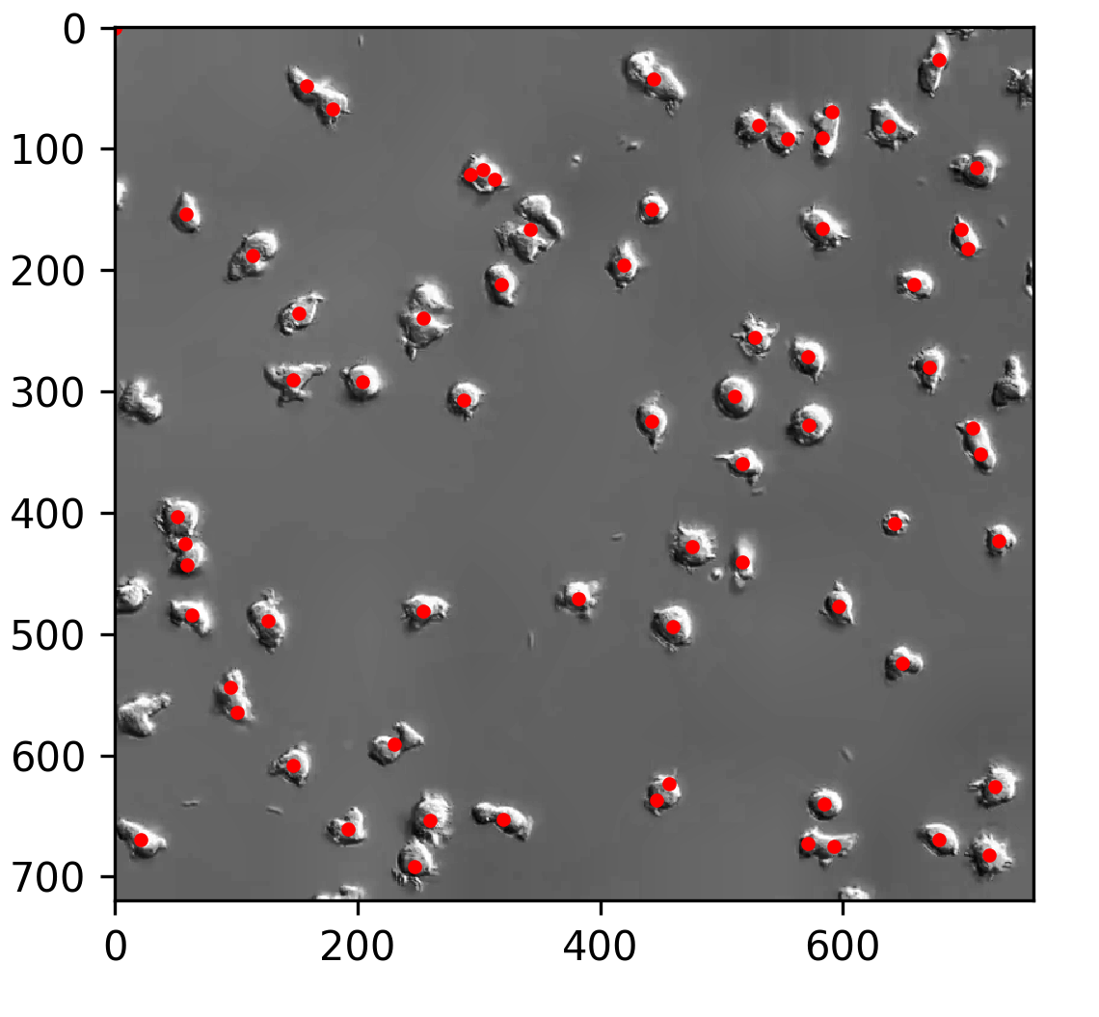
Labelling the cells on an image

Slide 61
Labelling the cells on an image
Hurray, now we can see the fruits of our labor. Of course our chosen strategy is not completely perfect. This is usually how image processing goes. We may need to go back and forth several times to get the separation just right.

Slide 62
Checking our segmentation on all images
Okay now we have a function for segmenting and a means to view the result it is time to apply it to all images in the movie.
As before we can do this with for loops.
We are going to be saving the labelled image at each step so we can see how well we have done.

Slide 63
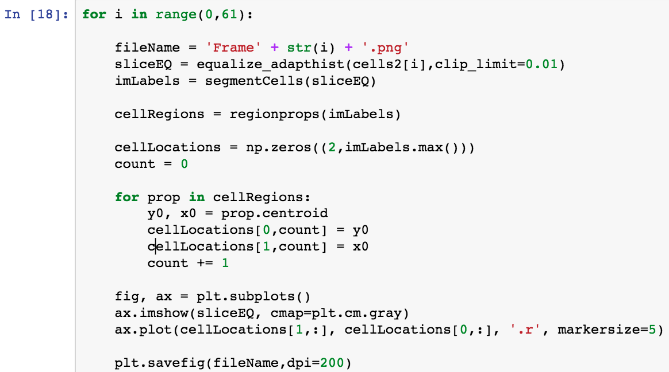
Checking our segmentation on all images

Slide 64
Checking our segmentation on all images
Note this time we are saving a figure rather than showing it. We can use the individual images later to make a movie

Slide 65
The final result

Slide 66
Wrapping up
This is the end of the class but hopefully you’ve now got some insight into tackling your own processing tasks.
Obviously this is only the very tip of the iceberg, I encourage you to check out the skimage gallery and other resources to learn more.
Of course if you have any questions feel free to email me.
Thank you so much for your participation.

Slide 67
Workshop survey
SurveyMonkey for classroom
SurveyMonkey for WebEx

Slide 68
Extra credit
Can you use the code we wrote to track a single cell and compute how far it travels?
Extend this for all cells in the field of view?
Monitor how a cells size changes over the time series?
How about plotting the vectors of the cells movements?

Slide 69
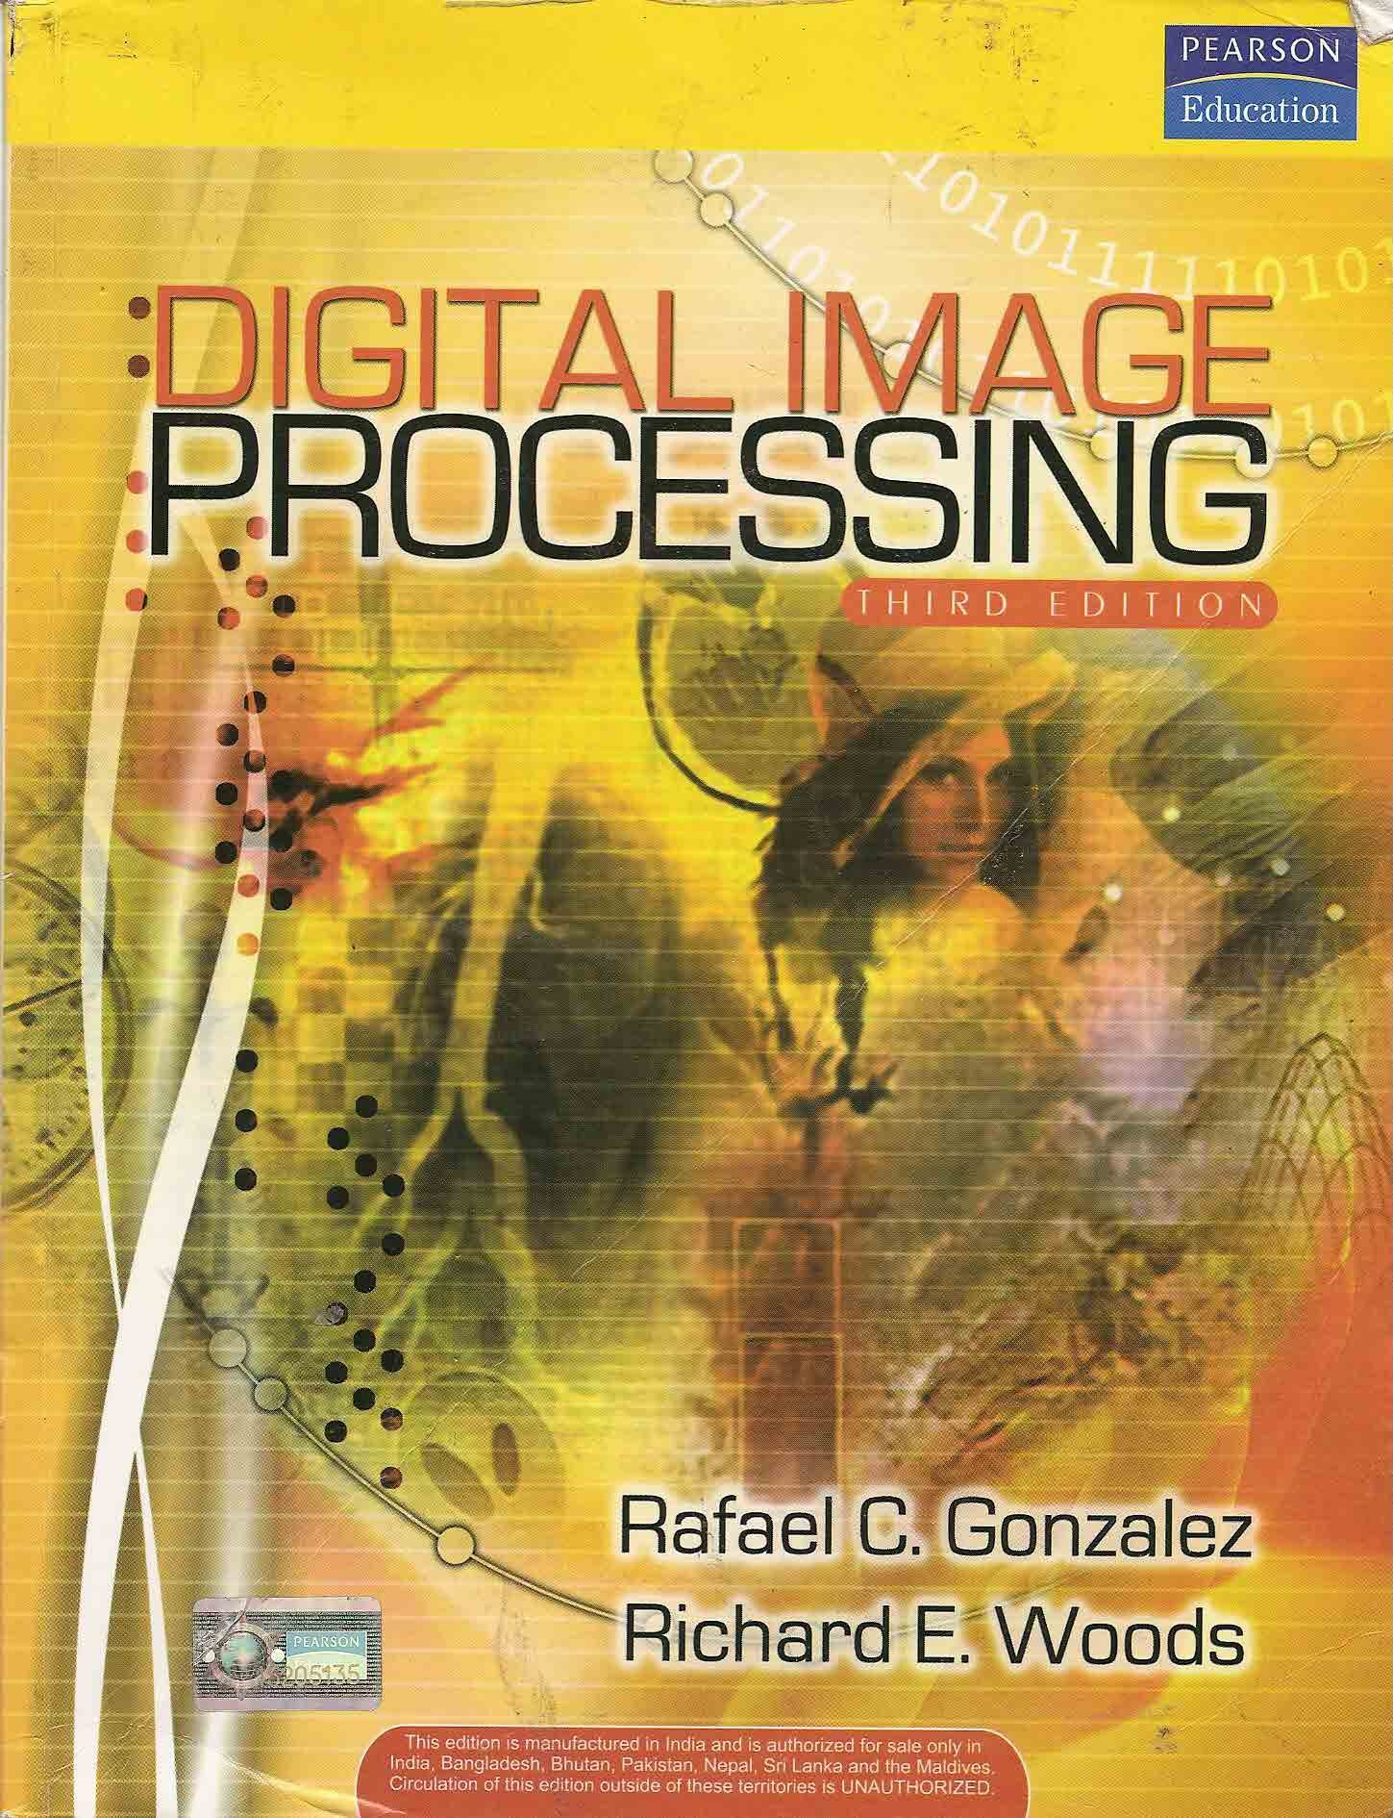
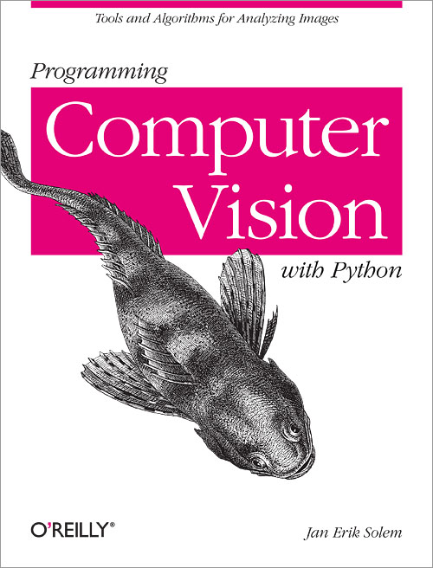
For more information
http://web.ipac.caltech.edu/staff/fmasci/home/astro_refs/Digital_Image_Processing_2ndEd.pdf
http://programmingcomputervision.com/

